Slide 1
Software Engineering and Architecture
Code Coverage
Quality of your Test Cases (?)

Slide 2
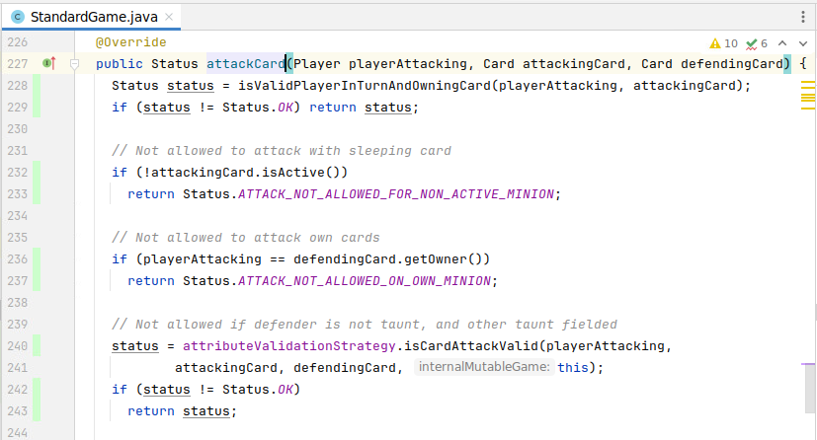
BlackBox and WhiteBox
Whitebox (WB) testing (glassbox / structural)
If we know the structure of code, we may construct test cases that ensures we run through all parts of it – ensure all ‘structural’ elements are ”working”.
input
output

Slide 3
Program structures
Basically any program is a combination of only three structures, or basic primes
sequential: a block of code {...}
decision: a switch if, switch, ...
iteration: a loop while, repeat, do,
WB focus on these basic primes and allow us to
evaluate test sets with respect to their ability to exercise these structures
thus – evaluate quality of test sets (Hm….)
and thus judge if a test set should be improved

Slide 4
Adequacy
A necessary result of this focus is on adequacy (Da: Tilstrækkelighed(?), dækning)
Example:
A test set T ensures that 100% of all statements in the production code P are executed.
T is statement adequate for P.
More often used term: “T ensures statement coverage for P”
If less than 100% are executed then T is not statement adequate for P.
Note: IntelliJ calls it ‘line coverage’ which is actually confusing
“int x = 8; int y = 9” is one line and two statements...
“kode-linjerne er 100% dækket af test”

Slide 5
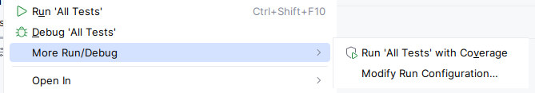
Example
(With some fear,) I ran IntelliJ’s code coverage tool on my own HotStone solution code…
Notes:
One missing line is because it is driven by a test in another subproject ☹

Slide 6
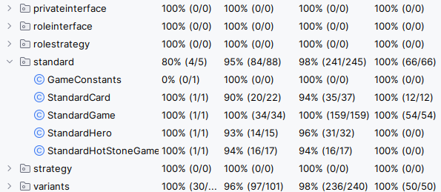
Example
Conclusion: My StandardGame is 100% statement adequately covered by test.
Result
Notes:
One missing line is because it is driven by a test in another subproject ☹

Slide 7
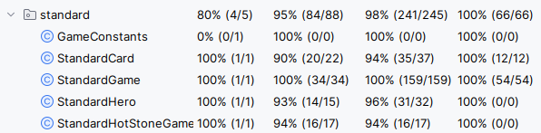
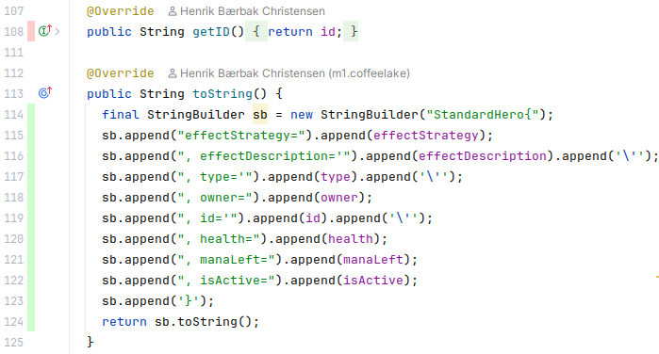
But?
Why this low number for my Hero???
Am I to be worried?
No…
getID() is obvious implementation...
toString() is auto-generated by IntelliJ

Slide 8
Key Points
In my toolbox I perceive Code Coverage tools to help me
Spot weaknesses in my testing
Huh??? Why do I not get 100% statement coverage of my Hero???
I will have to investigate that!
But getting 100% often introduce extra work with no value
Spring 2025 I actually invested time to increase my coverage

Slide 9
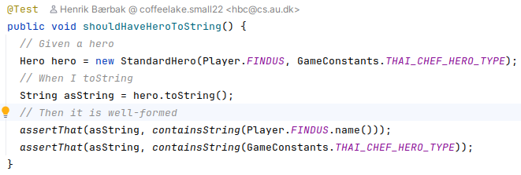
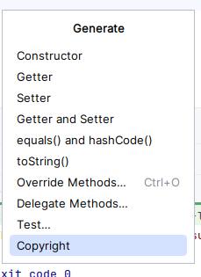
A Coverage Induced Test
So I actually looked for missing line coverage, and then introduced test cases to cover them
Ala
But...
It is not TDD – toString() was generated by Intellij
Thus – bit waste of time...

Slide 10
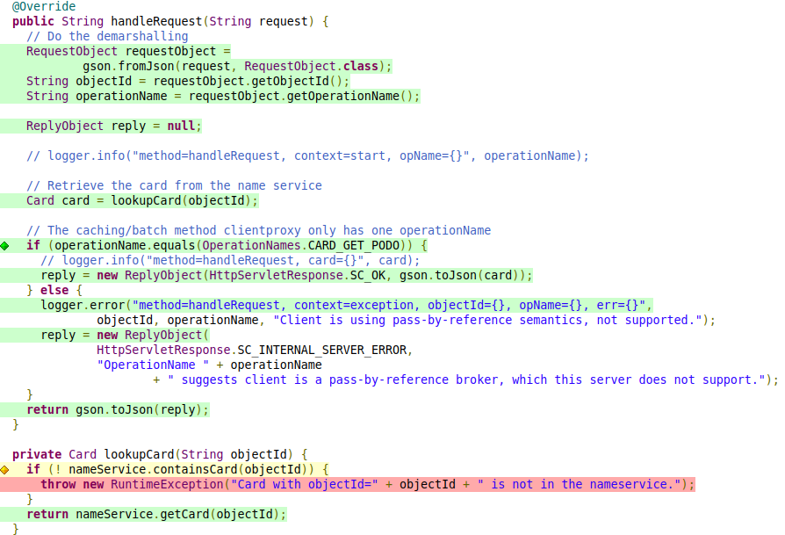
But good to find weak spots
Coverage helps me to spot aspects I have overlooked
Often the red lines are in error handling
Example
Server side code to handle Card
Notes:
Code from 26-09-2024 of hotstone

Slide 11
Example
If card not found in the nameService then the server will fail!
Maybe crash!
Better fix that!
Notes:
Code from 26-09-2024 of hotstone

Slide 12
Adequacy Criteria

Slide 13
Criteria
There are numerous adequacy criteria. WB focus on program-based criteria but others are useful also in BB and other types of testing.
WB criteria
statement coverage
method coverage
decision coverage
path coverage, and many more
Other types of criteria
use case coverage (system level)
interface coverage (integration level)

Slide 14
Aspects of WB
WB look at code
Corollary:
WB does not start until late in the development process
BB can be started earlier than WB
Corollary:
WB is only feasible for smaller UUTs
because the flow graphs (see later) explode in large units
BB can be used all the way to system level
Corollary:
WB is expensive for unstable UUTs
because implementation changes invalidate the analysis!
BB survives if the behavior + interface are stable

Slide 15
WB Coverage types
Overall, there are a number of metrics for coverage:
statement coverage
decision coverage
condition coverage
decision/condition coverage
multiple-condition coverage
path coverage
They all relate to the flow graph of code.

Slide 16
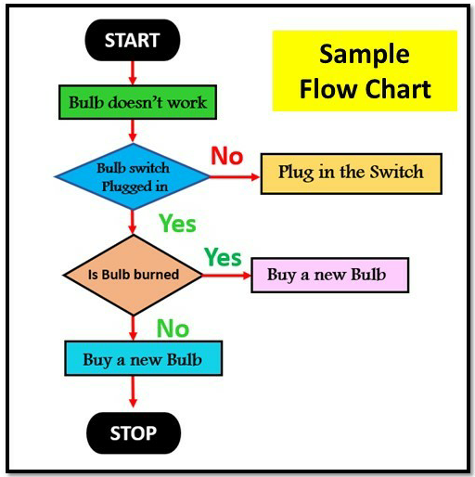
Flow graph/Flow chart
The flow graph (Da: Rute diagram) is simply a diagram that shows the flow of execution. Really old school ☺
It defines a graph where nodes are basic primes (block, decision, iteration) and edges are control flow between them (the ProgramCounter ☺).

Slide 17
Example
Danish Tax

Slide 18
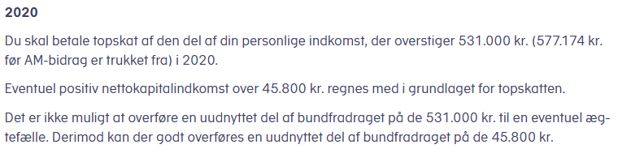
Source of Complex Algorithms
Danish Topskat
Limitation
Only look at unmarried person (which simplifies it greatly)
Exercise: complete the analysis ☺

Slide 19
Design
Direct – functional – approach
EC analysis?
Booleans
Below and above ‘bundfradrag’
531.000 for personal income true/false
45.800 for capital income true/false
However, we will look at the code for a WB analysis
Exercise: Do the EC analysis and compare…
Notes:
Meta: Code in frs/project/Danish-top-skat

Slide 20
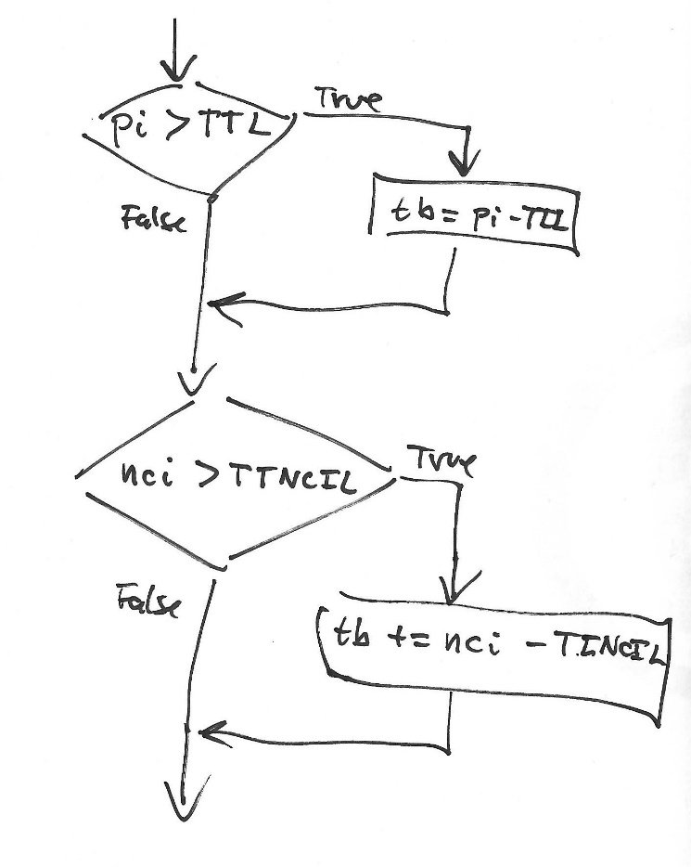
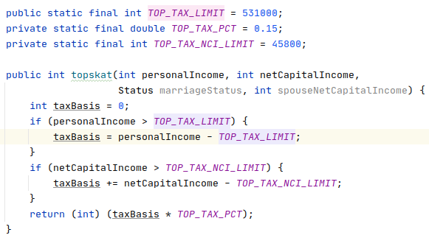
Code and Flow Graph
Note: On purpose this code is full of defects!

Slide 21
Paths in Flow Graph
We can name paths in the flowgraph by the subpaths
E.g
acd
abe
abd
ace
a
c
b
e
d

Slide 22
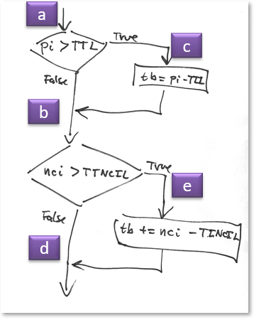
Statement coverage
Statement coverage (SC):
Requires every statement in the program to be executed at least once
Exercise:
which path satisfy SC criterion?

Slide 23
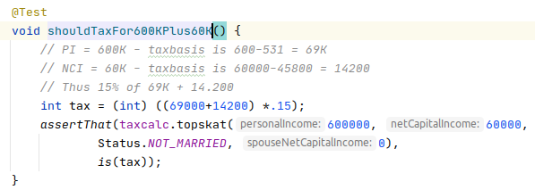
Statement coverage
SC criterion is pretty weak.
Path ace is enough.
A single test case suffice, which ensures path c and path e...

Slide 24
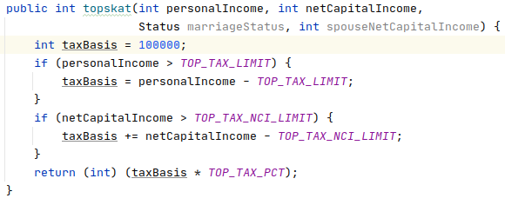
But SC is a Weak Coverage
Easy to introduce an error that our test case will not find
Code is correct only when personal income is above 531.000 kr. (As taxBasis is reset correctly, then)

Slide 25
Decision coverage
Decision coverage (branch coverage):
Requires each decision has a true and false outcome at least once
Decision 1:
pi > TTL
Decision 2
nci > TTNCIL
Exercise:
which paths satisfy DC criterion?
Notes:
Answer: ace og abd

Slide 26

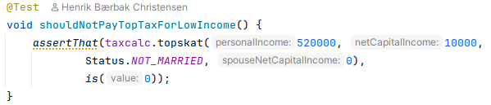
Decision coverage
DC criterion is better
TC1: D1 true D2 true
TC2: D1 false D2 false
Will find our ‘taxbasis = 100.000’ bug

Slide 27
Tooling
Painting our code ☺

Slide 28
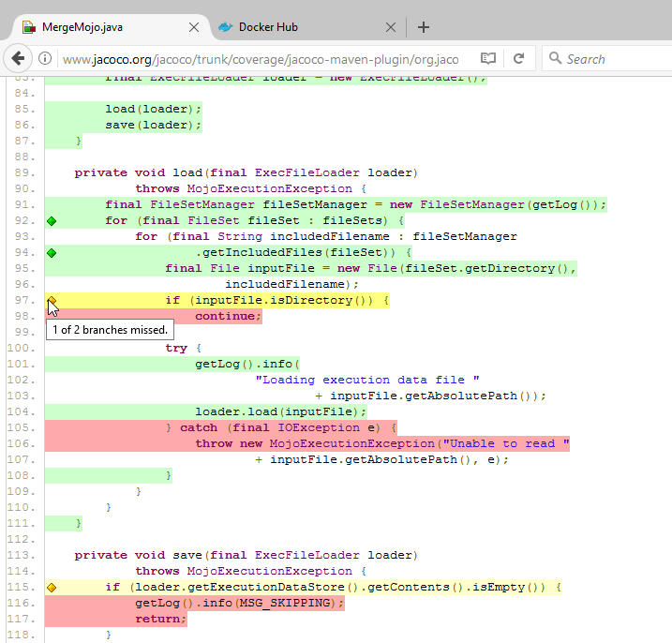
JaCoCo
Measures
Statement coverage (*)
(*) Actually bytecode!
Decision coverage
Call it ‘branch coverage’
Exceptions not counted
Green: Covered
Yellow: Partially Cov.
‘some branches’ covered
Red: Not Covered

Slide 29
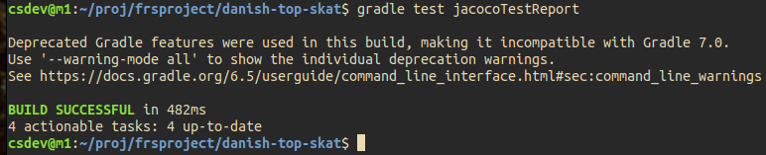
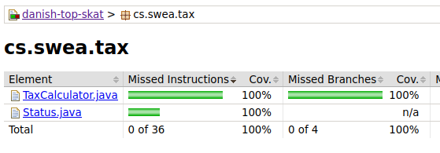
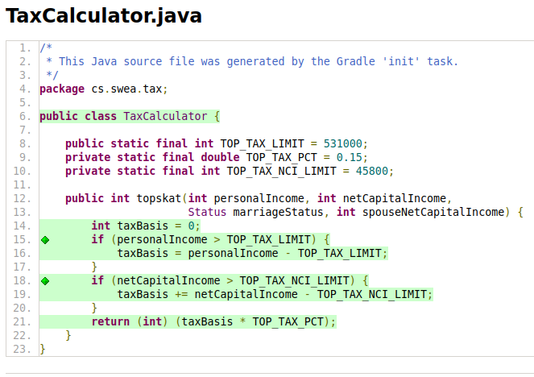
Our Tax Code

Slide 30
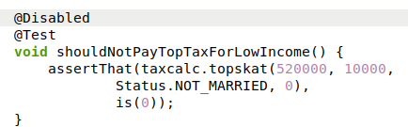
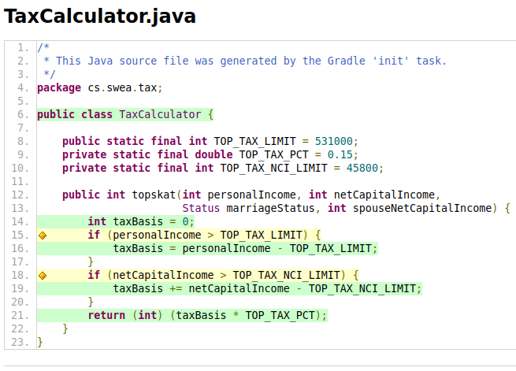
Flagging Missed Branches:
Disabled the low income test case and ran again...
You can actually see if it is the true or false branch that is missed here. How?

Slide 31
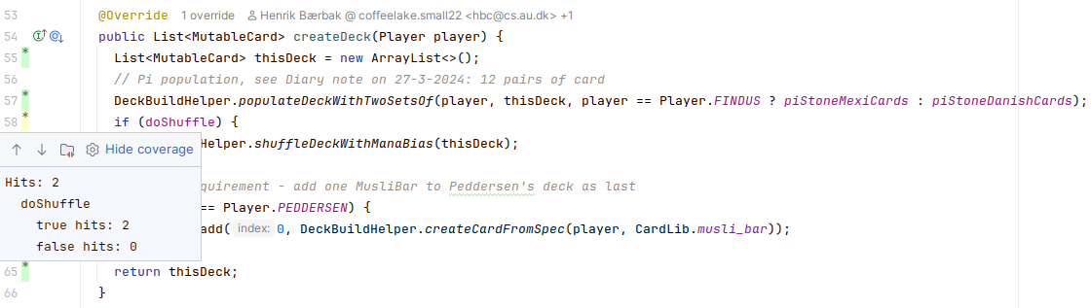
IntelliJ
Up until E24, IntelliJ did not do branch coverage, but it has changed ☺
Click on the ‘yellow’ marking and you will see which branch was and was not taken!
The branch was not covered for ‘doShuffle == false’
[Puzzling as this is the test flag; but was used in another gradle project, so...]

Slide 32
Back to Coverage

Slide 33
Decision coverage
But an import aspect remains in the code that DC’s does not find?
Which is?
… that it only handles unmarried persons
The married stuff is not implemented yet ☺

Slide 34
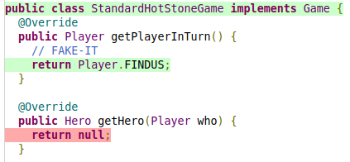
WhiteBox Test…
... looks at the code that is
Not the specification ☺…
Thus, the whole un-implemented part of handling married people is not treated at all, yet the test cases pass and the DC coverage is adequate…
Another example:
Is 100% statement coverage of ‘getPlayerInTurn()’ a good thing?

Slide 35
And…
The other coverage metrics are not considered in SWEA.
Like condition coverage
If (a && b || c)
All expressions must each evaluate to both true and false
Like multiple-condition coverage
If (a && b && c && !d)
All combinations of true/false of a, b, c, and d must be covered
And most Code Coverage tools out there cannot even compute them…
From a practical point of view
Complex to compute and make test cases for
I doubt the return on investment, but – a personal gut feeling...

Slide 36
Summary

Slide 37
Code Coverage Metrics
Statement Coverage
Tests execute every statement at least once
Decision Coverage
Tests execute every decision to true AND false at least once
Code Coverage Tool
Is nice to review in order to inspect potential code blocks that you have forgotten to write test code for…

